Slide 1

IOT-BASED AIR QUALITY INDEX METER
BY
HUZAIFA SHAHBAZ[21-CE-009]
SUPERVISOR:MAAM SARA TEHSIN

Slide 2
OUTLINES
INTRODUCTION
PROBLEM STATEMENT
LITERATURE REVIEW/BACKGROUND
PROPOSED DESIGN/METHODOLOGY
HARDWARE/SOFTWARE TOOLS
PROPOSED WORK PLAN
REFERENCES

Slide 3
INTRODUCTION
In an era, the integration of IOT environmental monitoring systems, particularly Air quality Index(AQI) systems, is crucial for public health and environmental protection.
IOT technology connects sensors to measure air pollutants like PM2.5, PM10, CO and NO₂.
Data is transferred to a central server for analysis and accessibility.
It also plays a crucial role in shaping policies and raising awareness.
This real-time monitoring helps mitigate poor air quality impacts, shapes policies and raise awareness about maintaining a healthy environment.
IOT based AQI systems enable continuous monitoring of air pollutants, providing timely insights and prompt responses to deteriorating air conditions.

Slide 4
PROBLEM STATEMENT
The primary issue with this project is its lengthy detection range, which prevents it from accurately displaying the city's air quality reading on the sensors.
The project aims to identify key pollutants, analyze their impact on health and the environment and develop a robust system for continuous monitoring.
The solution’s business scope includes urban planning, public health management and industrial compliance with primary end-users being environmental agencies, local governments, industries and the public.
Urbanization and industrialization have led to a decline in air quality, posing health risks and environmental issues. A project aims to develop an IOT-based AQI system to monitor air pollutants in real-time enabling timely interventions and informed decision-making.

Slide 5
LITERATURE REVIEW/BACKGROUND
STUDY | AUTHORS | YEAR | KEY FINDINGS
Deployment of Low-Cost Sensors | Kumar et al. | 2019 | The study showcased the efficacy of low-cost, IoT-based sensors in monitoring scalable air quality.
Predictive Analytics in AQI Systems | Smith and Lee | 2020 | The integration of machine learning for predictive analytics has been highlighted as a method to improve early warning systems.
Real-Time Data for Public Health | Johnson et al. | 2021 | The use of real-time, IoT-based air quality data has significantly enhanced public health responses.
Enhancing Environmental Awareness | Chen and Patel | 2022 | The article highlighted the significant role of IoT in enhancing public engagement and raising awareness about air quality issues.
Notes:
Table 1:LITERATURE REVIEW OF AIR QUALITY INDEX

Slide 6
PROPOSED DESIGN/METHOGOLDY
ABSTRACT DESIGN
The IoT-based Air Quality Index Meter uses advanced sensors to monitor air quality in real-time, transmitting data via wireless to a cloud-based platform for accurate, reliable, and user-centric monitoring.
COMPONENT LEVEL DESGIN
The project involves designing sensor modules, microcontrollers, and communication interfaces for data acquisition, processing, transmission, and seamless transfer between sensor nodes and cloud platforms.
SRS
The SRS document will outline the functional and non-functional requirements of an air quality index meter, ensuring accurate pollutant measurement, real-time data transmission, user alerts, and performance metrics.

Slide 7
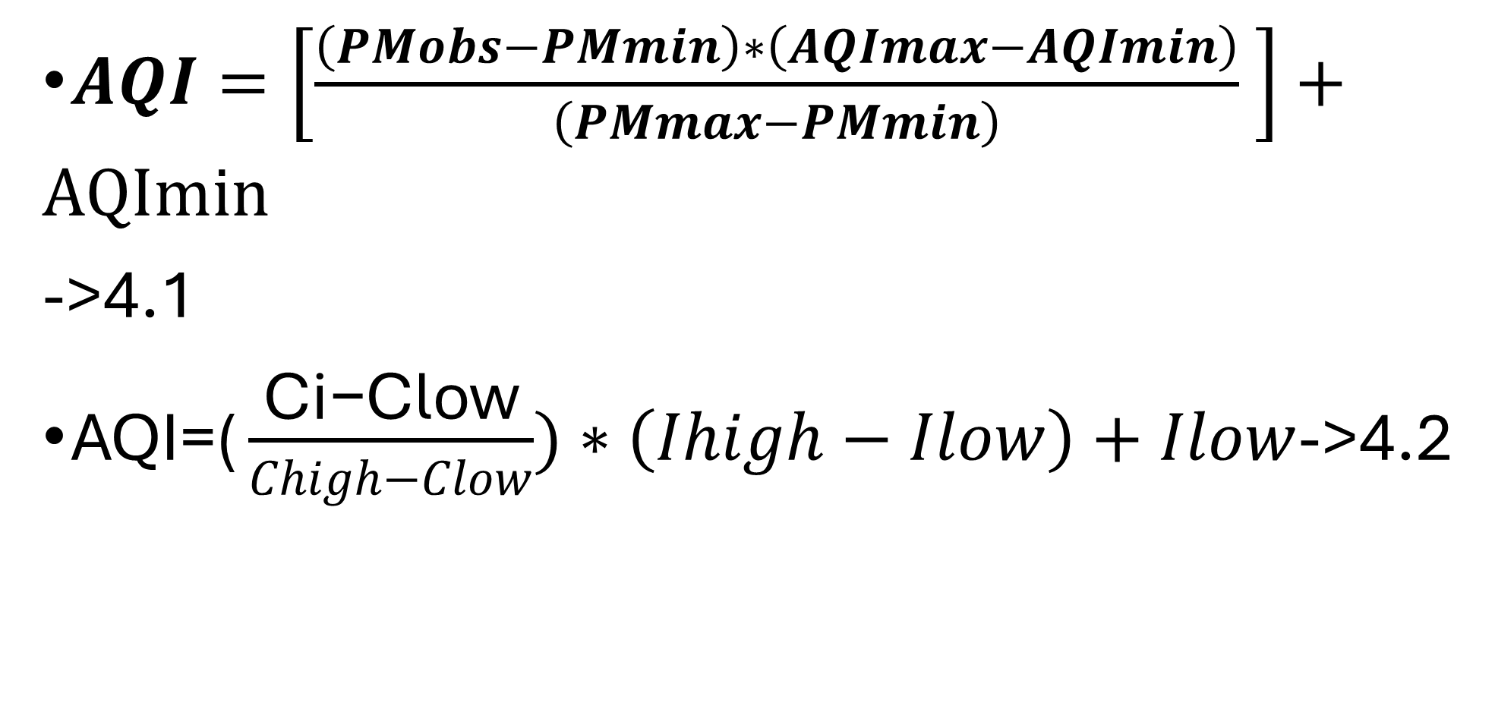
PROPOSED DESIGN/METHOGOLDY
$AQI=\left[\frac{\left(PMobs−PMmin\right)∗\left(AQImax−AQImin\right)}{\left(PMmax−PMmin\right)} \right]+AQImin$
->4.1
$\text{AQI}\text{=(}\frac{\text{Ci}\text{−}\text{Clow}}{Chigh−Clow})∗\left(Ihigh−Ilow\right)+Ilow$->4.2

Slide 8
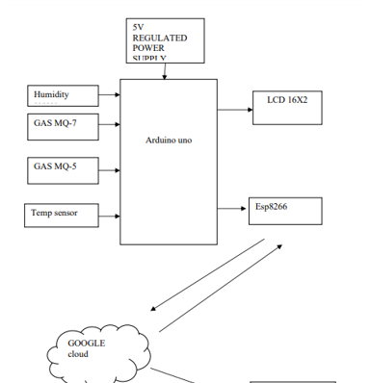
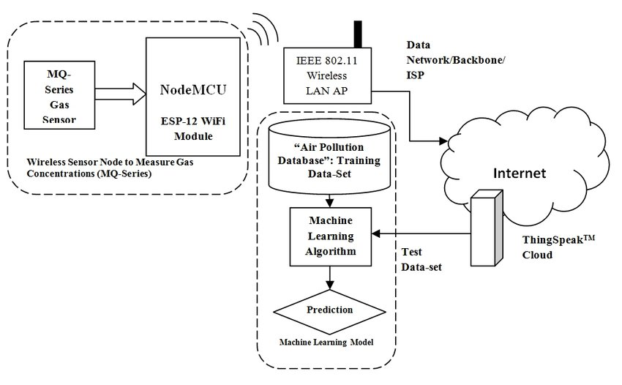
PROPOSED DESIGN/METHOGOLDY
FIGURE 1:BLOCK DIAGRAM OF IOT BASED AQI METER
FIGURE 2:PROJECT DIAGRM OF IOT BASED AQI METER

Slide 9
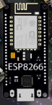

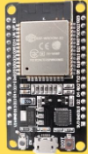
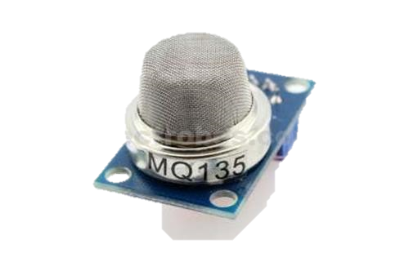
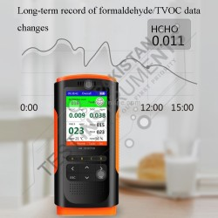
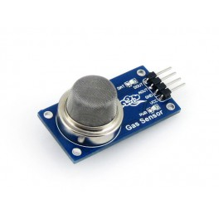
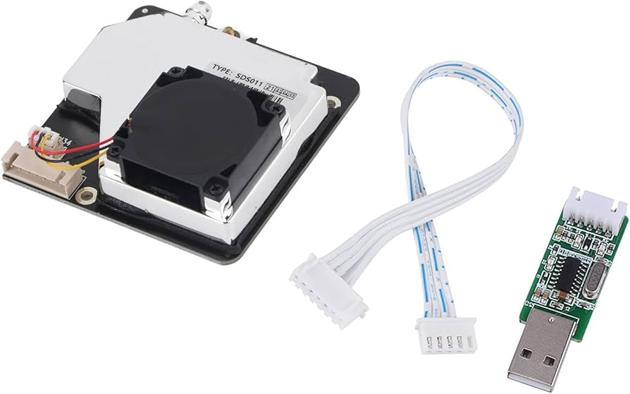
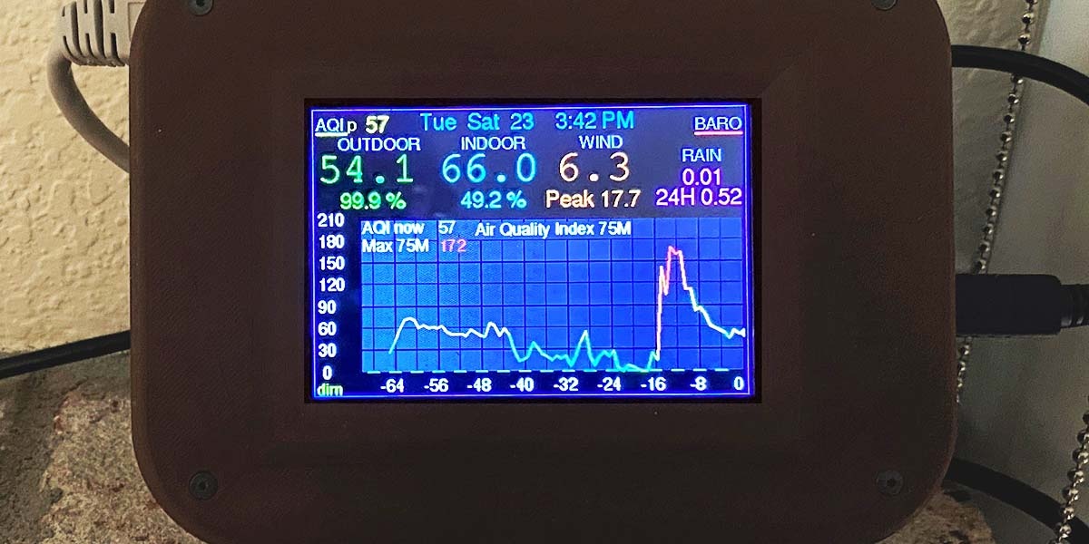
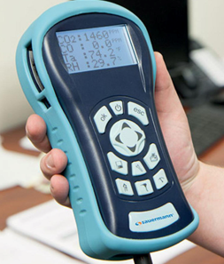
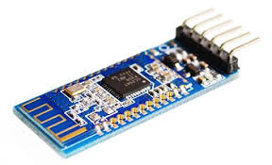
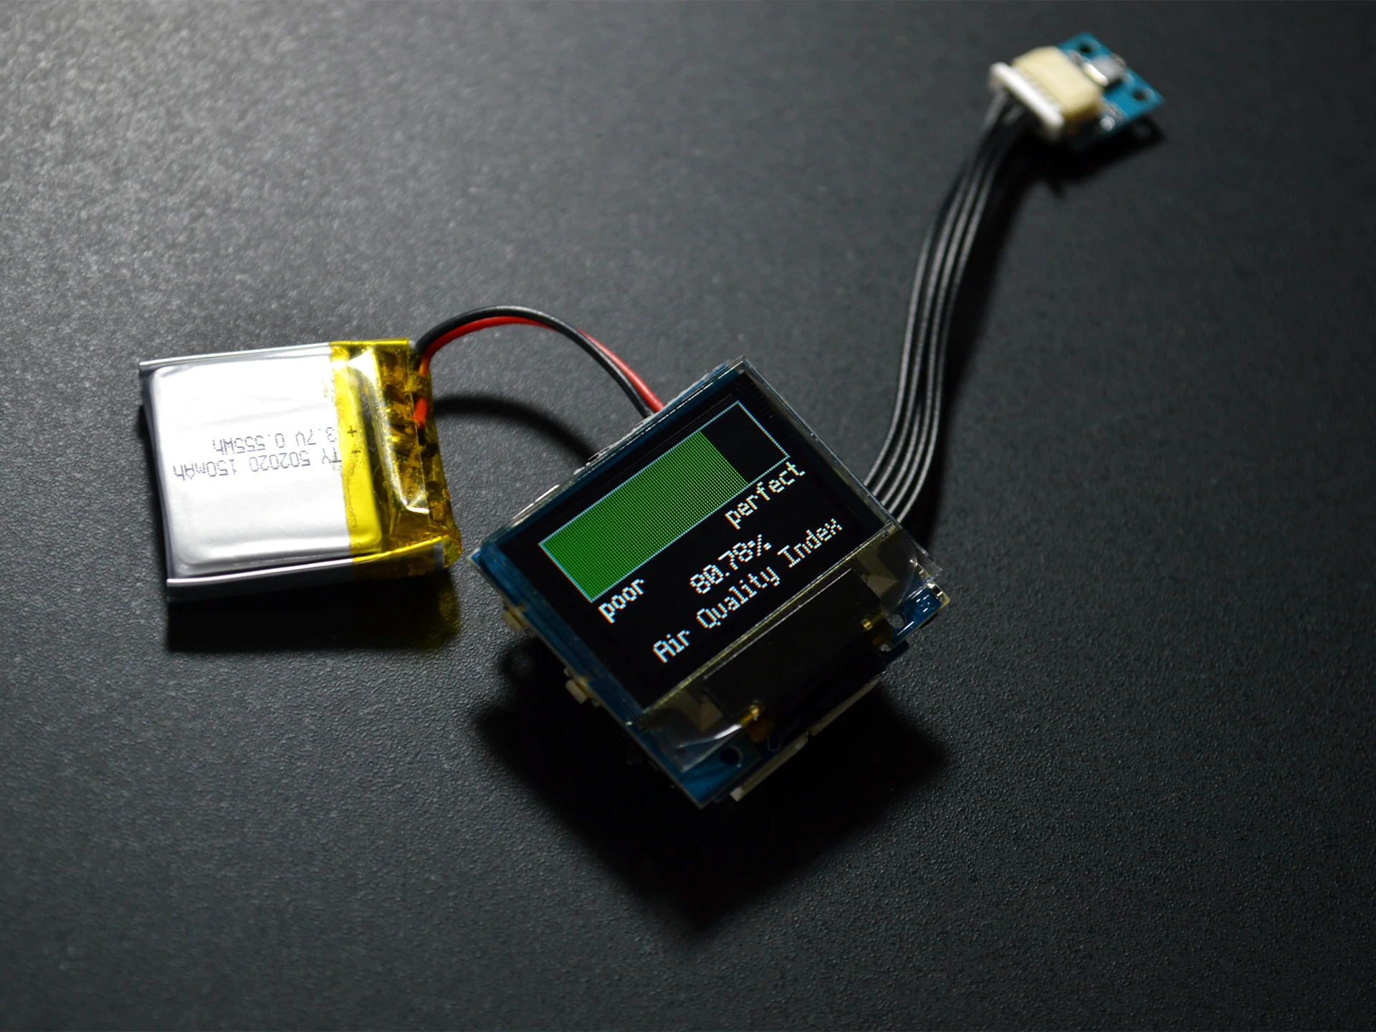
HARDWARE TOOLS
1:ESP32/ESP8266
2:ARDUINO
3:MQ SERIES GAS SENSOR(MQ-135 OR MQ-5)
4:PM2.5 AND PM10 SENSORS
5: BATTERY PACK
6: POWER ADAPTER
7: CHARGER SETUP
8: WEATHERPROOF HOUSING
9: WiFi/BLUETOOTH MODULES

Slide 10

















SOFTWARE TOOLS
1: ANDORID STUDIO
2: FIREBASE
3:BLYNK APP
4:MATLAB
5:PYTHON
6: ARDUINO FRAMEWORK
7:VS CODE FOR FIRMWARE CODING
8: THINGS SPEAK
9:MQTT PROTOCOLS
10: AWS IOT
11:ADAFRUIT IO
12:GITHUB
13: AUTHENTICATION MECHANISMS
14: GAFRANA
15:EXCEL
16:HTTP/HTTPS
17:SENSOR AND WiFi LIBRARIES

Slide 11
PROPOSED WORK PLAN
1. Identify Project Modules/Features/Tasks/Activities
MODULE 1: Requirement Analysis and Research
MODULE 2: System Design
MODULE 3: Hardware Assembly and Testing
MODULE 4: Software Development
MODULE 5: System Integration and Testing
MODULE 6: Deployment and Documentation
2. Time Needed to Implement Each Module/Feature/Task/Activity
Module 1: Requirement Analysis and Research - 2 weeks
Module 2: System Design - 3 weeks
Module 3: Hardware Assembly and Testing - 4 weeks

Slide 12
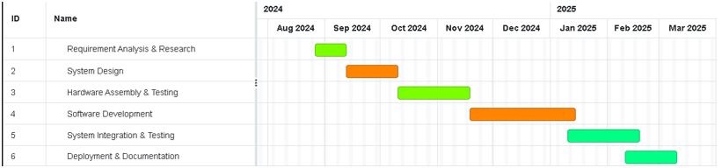
PROPOSED WORK PLAN(CONTINUED
Module 4: Software Development - 6 weeks
Module 5: System Integration and Testing - 4 weeks
Module 6: Deployment and Documentation - 3 weeks
Semester-wise Workload Plan:
Semester 7:
Focus on Modules 1, 2, and part of Module 3.
Semester 8:
Focus on completing Module 3 and Modules 4, 5, and 6.
4. Gantt Chart for IoT-Based AQI Meter Project
Notes:
1:Requirement Analysis & Research
START DATE: 26Aug 2024
FINISH DATE: 12Sep 2024
DURATION:14 days
2: System Design
START DATE: 12Sep 2024
FINISH DATE: 10Oct 2024
DURATION:21 days
3:Hardware Assembly and Testing
START DATE: 10Oct 2024
FINISH DATE:18 Nov 2024
DURATION:28 days
4: Software Development
START DATE: 18 Nov 2024
FINISH DATE:14 Jan2025
DURATION: 42 days
5: System Integration and Testing
START DATE: 14 Jan2025
FINISH DATE:20Feb2025
DURATION:28 days
6: Deployment and Documentation
START DATE: 20Feb2025
FINISH DATE: 20Mar 2025
DURATION:21 days

Slide 13
CONCLUSION
In conclusion, the IoT-based Air Quality Index (AQI) Meter is a cost-effective solution for real-time monitoring of air quality.
It collects, analyzes, and displays data, providing insights for proactive pollution mitigation and public health protection.
The system integrates sensors, cloud connectivity, and data visualization tools, ensuring accurate readings and informed decision-making.
This project could significantly contribute to environmental monitoring and improve quality of life by addressing air pollution challenges.

Slide 14
REFERENCES
1:Dineshkumar, T., V. Suresh Babu, Pachaivannan Partheeban, and R. Puviarasi. "Air Quality Monitoring System Based on IoT." *Journal of Physics: Conference Series* 1964, no. 6 (2021): 062081. https://doi.org/10.1088/1742-6596/1964/6/062081.
2: Hemalatha, M., R. Arunprasath, J. Shalini Priya, A. M. Shivashankari, K. Rajkumar, and R. Jeyashri. "An IoT Enabled Air Pollution Meter with Digital Dashboard on Smartphone." In 2023 Intelligent Computing and Control for Engineering and Business Systems (ICCEBS), IEEE, 2023. https://doi.org/10.1109/ICCEBS58601.2023.10448896.
3: Yusof, Khairul Huda, M. Abdulrazaq, Fadhilah Aman, M. N. Mohammed, Amirul Asyraf, Ahmad Sukri Ahmad, and Mohamad Syahrul Zahwan Mohd Zabidi. "Design and Development of Real Time Indoor and Outdoor Air Quality Monitoring System Based on IoT Technology." In 2022 IEEE 18th International Colloquium on Signal Processing & Applications (CSPA 2022), Selangor, Malaysia, May 12, 2022. IEEE. https://doi.org/10.1109/CSPA55076.2022.9781937.
4: Yusof, K. H., Abdulrazaq, M., Aman, F., Mohammed, M. N., Asyraf, A., Sukri, A., Zabidi, M. S. M., & Alayham, A. R. (2022). Design and Development of Real Time Indoor and Outdoor Air Quality Monitoring System Based on IoT Technology. 2022 IEEE 18th International Colloquium on Signal Processing & Applications (CSPA 2022), 12 May 2022, Selangor, Malaysia.
https://ieeexplore.ieee.org/document/9781937

Slide 15
REFERENCES
5: Sharmila, A. R., J. J. Edwin, T. Sivakumaran, A. P. Prabhu, and R. T. Rajesh. 2022. "Design and Development of Real Time Indoor and Outdoor Air Quality Monitoring System Based on IoT Technology." In *Proceedings of the 2022 IEEE 18th International Colloquium on Signal Processing & Applications (CSPA 2022)*, 187-192. Batu Ferringhi, Malaysia: IEEE. https://doi.org/10.1109/CSPA53698.2022.9779578.
6: IoT Based Air Quality Monitoring System Using Arduino Shazia Afroze 1 , Md. Istiak Hossain Paran 2 , Rakibul Hasan Roki 3 1Assistant Professor, Dept. of Electrical & Electronic Engineering, Stamford University Bangladesh (SUB) 2,3Student, Dept. of Electrical & Electronic Engineering, Stamford University Bangladesh (SUB). https://www.ijfmr.com/papers/2023/2/2260.pdf
7: IoT Based: Air Quality Index and Traffic Volume Correlation Omar Alruwaili; Ivica Kostanic; Ali Al-Sabbagh; Hamad Almohamedh. https://ieeexplore.ieee.org/document/9298176/references#references
8: IoT-based_air_quality_monitoring_systems_for_smart Danny Múnera Diana P. Tobon V.
Johnny Aguirre Natalia Gaviria. https://www.researchgate.net/publication/350823548_IoT-based_air_quality_monitoring_systems_for_smart_cities_A_systematic_mapping_study
9: IoT-based_AQI_Estimation_using_Image_Processing_and_Learning_Methods Nitin Nilesh; Ishan Patwardhan; Jayati Narang; Sachin Chaudhari. https://ieeexplore.ieee.org/document/10152272
10: IoT Based Air Quality Index (AQI) Monitoring with ESP8266 & Air Quality Sensor || Pollution in PPM. https://www.youtube.com/watch?v=Ub1ciur95Nk
11: How to Monitor Air Quality Using ESP32 | Air Quality Monitoring System | ESP32 | Blynk IOT Projects. https://www.youtube.com/watch?v=mvdpAeBVIEg

Slide 16
REFERENCES
12: ESP32/ESP8266 https://www.espressif.com/en/products/socs/esp8266/esp32
13:Arduino https://www.arduino.cc
14:MQ SERIES GAS SENSOR(MQ-135 OR MQ-5) https://quartzcomponents.com/products/mq-135-air-quality-gas-sensor-module?srsltid=AfmBOop5mXIPlIYk9hktUux7liYaVdUBpKL6kbz0WWrxTpIWOT2KrvzP https://quartzcomponents.com/products/mq-5-gas-sensor?pr_prod_strat=e5_desc&pr_rec_id=d76f6fda8&pr_rec_pid=4491697127559&pr_ref_pid=4491637817479&pr_seq=uniform
15:PM2.5 AND PM10 SENSOR https://www.aeroqual.com/sensors/particulate-matter-sensor-pm10_pm2-5
16:BATTERY PACK https://digilog.pk/products/3-7v-2400ma-li-ion-battery-pack-40mm-x-30mm-x-20mm?_pos=13&_sid=2e7bcb6e9&_ss=r
17:WiFi/BLUETOOTH MODULES https://www.electronicwings.com/nodemcu/hc-05-bluetooth-module-interfacing-with-nodemcu
18:ANDROID STUDIO https://developer.android.com/studio?_gl=1*ae3zhz*_up*MQ..&gclid=Cj0KCQjw28W2BhC7ARIsAPerrcIja-b-lMf3oSKZuIHQbv0cpPHynzM9mqTFolAh2u5Jwl_PLXT8ekQaAjBeEALw_wcB&gclsrc=aw.ds
19:FIREBASE https://firebase.google.com/?gad_source=1&gclid=Cj0KCQjw28W2BhC7ARIsAPerrcI94T6cSy7drbjU0zQU_a4MeNrUMZAfQ8a8eirac0VXoSY6-GZI_fwaAqw-EALw_wcB&gclsrc=aw.ds

Slide 17
REFERENCES
20:BLYNK APP https://blynk.io/no-code-iot-mobile-apps
21:MATLAB https://www.mathworks.com/products/matlab.html
22:PYTHON https://www.python.org https://www.anaconda.com
23:ARDUNIO IDE https://www.arduino.cc/en/software/
24:ESPRESSIF IDF https://idf.espressif.com
25:THINGS SPEAK https://thingspeak.com
26:MQTT PROTOCOLS https://mqtt.org
27:AWS IOT https://aws.amazon.com/iot/
28:ADAFRUIT IO https://io.adafruit.com
29:GITHUB https://github.com
30:AUTHENTICATION MECHANSIMS https://www.techtarget.com/iotagenda/tip/IoT-device-authentication-methods-that-increase-security
31:GAFRANA https://grafana.com

Slide 18
REFERENCES
32:EXCEL https://www.microsoft.com/en-us/microsoft-365/excel
33:HTTP/HTTPS https://aws.amazon.com/compare/the-difference-between-https-and-http/#:~:text=In%20short%2C%20HTTP%20protocol%20is,encrypted%20connection%20before%20transferring%20data.
34:SENSOR AND WiFi LIBRARIES https://www.arduino.cc/reference/en/libraries/wifi/
35:GANTT CHART https://www.onlinegantt.com/#/gantt

Slide 19




COLLABOTORS
BIOMISA OF NUST EME COLLEGE
RISETECH OF NUST EME COLLEGE
DR SAJID GUL KHAWAJA
DR USMAN AKARM

